Slide 1
INTERNSHIP 2021-2022
Global Terrorism Analysis and Death Occurrences Prediction
TEAM MEMBERS
HARISH M
III Year C
Mrs. R. Amirthavalli
DESIGNATION (AP – CSE)
SIGNATURE
Velammal Engineering College
Department of Computer Science and Engineering
Notes:
‹#›

Slide 2
Company’s Introduction
MIT Square is a premier product development company headquartered in Bangalore, India and has a presence in Southampton,UK. MIT expands as "Management and Innovation for Transformation" with a tagline "We transform your life".
MIT Square is an International Organisation for Standardisation, ISO 9001:2015, Certified Company. We at MIT Square, are experts in designing and developing innovative products, building start-ups, and understanding the need the enterprises for their business growth.
They offer product design, product development, product manufacturing and patent filing services. MIT Square excels in the design, development, manufacturing and supplying of consumer products, industrial and IoT devices, education platforms, hospitality products, and healthcare technology.
We offer turnkey, tooling and OEM/ODM services. From individuals, start-ups, small and medium-sized companies to international corporations, MIT Square is here to support you in all your product design & product development needs and pave the way to transform your life by turning your ideas into reality
Velammal Engineering College
Department of Computer Science and Engineering

Slide 3
Problem Statement
The GTD defines a terrorist attack as the threatened or actual use of illegal force and violence by a non-state actor to attain a political, economic, religious, or social goal through fear, coercion, or intimidation. In practice this means in order to consider an incident for inclusion in the GTD, all three of the following attributes must be present:
The incident must be intentional;
The incident must entail some level of violence or immediate threat of violence;
The perpetrators of the incidents must be sub-national actors;
Our goal is to ,
To analyze the data to get insights on Global terrorism
To predict the Death Occurrences
Velammal Engineering College
Department of Computer Science and Engineering
Notes:
‹#›

Slide 4
Proposed Solution
For analysis I have used Tableau most because Tableau is one of the most powerful visualisation software. For
predicting the death occurrences, a random forest classifier was used with help of python with google Colab. My
final model achieved 86 % accuracy.
LIBRARIES USED IN MACHINE LEARNING
● KNeighborsClassifier()
● AdaBoostClassifier(random_state = 41)
● RandomForestClassifier(random_state = 41)
● GaussianNB()
● MLPClassifier()
Velammal Engineering College
Department of Computer Science and Engineering
Notes:
‹#›

Slide 5
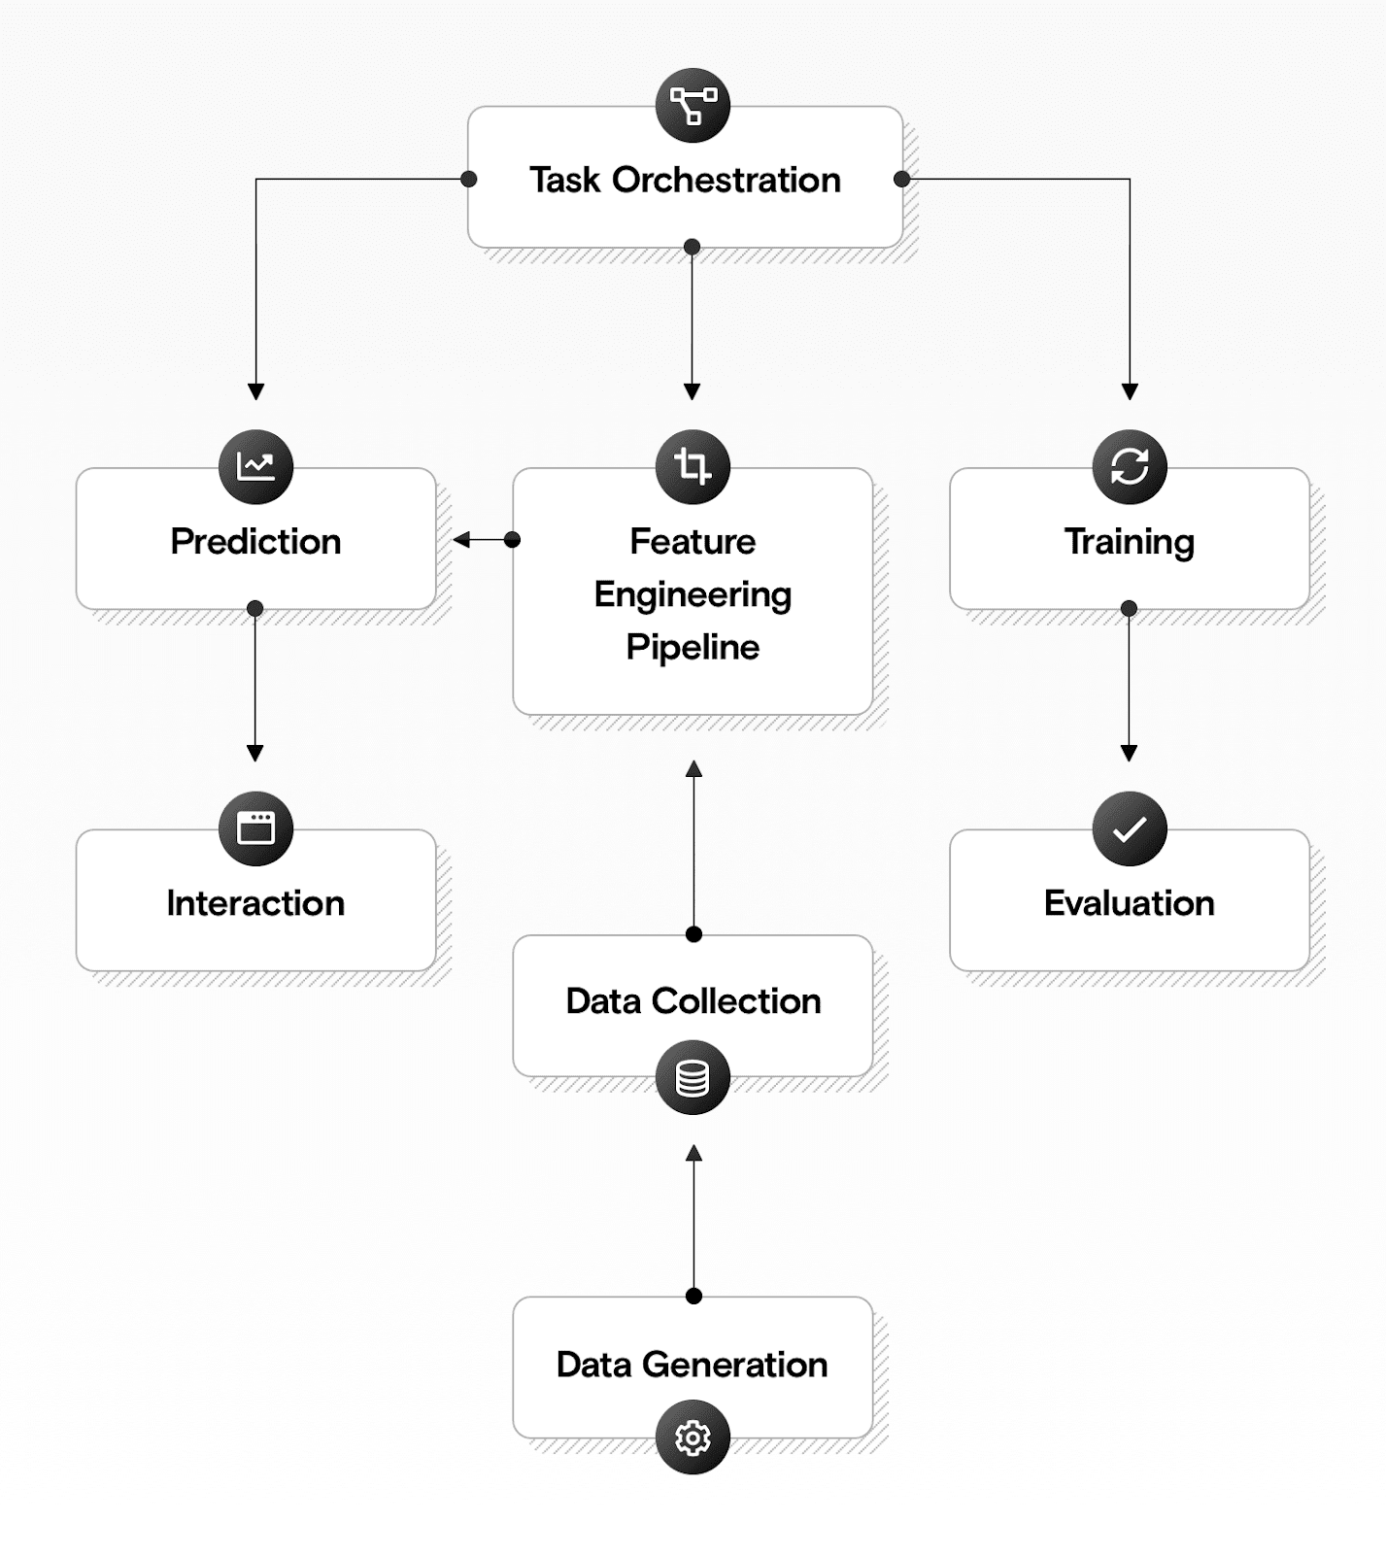
Architecture / Design of the Proposed Solution
Velammal Engineering College
Department of Computer Science and Engineering

Slide 6
Modules of the Project
First we are gonna find Insights
Then we have to perform Train_Test_Split
Then Training and Predicting Pipelines of different models to choose the best.
Then analysing the result of Classifier Models
Roc Curve
Velammal Engineering College
Department of Computer Science and Engineering

Slide 7
Conclusion
Terrorist attacks are among the causes of national instability. A clear understanding of how this event is occurring will help us to conduct more in-depth investigations. Through this research, it is possible to conclude that the use of Machine Learning techniques was able to visualise and predict Death occurrences.
The results section shows that there has been a considerable growth in terrorist attacks since 2010 and that due to the classification models, it was possible to determine the probability of which region and type of attack may occur.
Concerning the number of attacks by region in the visualisation, it was obtained that there is a probability that they will happen in the Middle East & North Africa and followed by South Asia. Regarding the types of attacks, there is still the probability that bombs and explosions are involved, followed by armed assault. The results have been successfully achieved by using the historical data collected from the GTD.
The models that were made through Random Forest give the same probabilistic results from 86% of assertiveness.
The robustness of the proposed prediction has been evaluated using various performance metric like accuracy, specificity, sensitivity, f1 score and ROC curve Taliban , ISIL , Al - shabaab , Boko Haram are the most notorious groups that cause threats.
Most the terrorist attacks happen for the various factors and motivation as well, thus even with using powerful deep learning model over the global terrorist database this not sufficient to determine what are the next attacks instead rising suspicions. To achieve such goal we have to study the behavior of the terrorist over social networking.
Velammal Engineering College
Department of Computer Science and Engineering

Slide 8
THANK YOU
Velammal Engineering College
Department of Computer Science and Engineering

